Slide 1


Slide 2
Presentation Topic
Use Case and Sequence Diagrams in Software Engineering

Slide 3



Group Members
MUHAMMAD IRTISAM
MUHAMMAD UMER
FATIMA NASIR
RIZWA ASAD
ALISHA CHAUDHARY

Slide 4
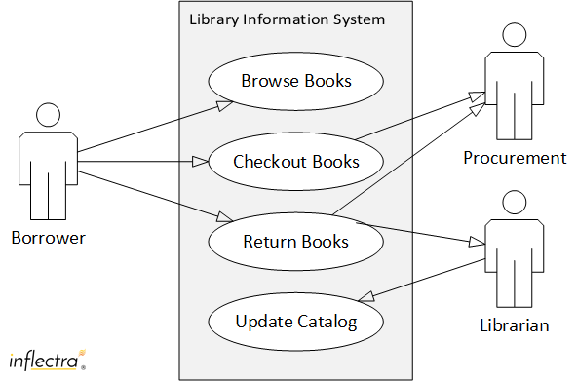
Purpose and Benefits of Use Case Diagrams
System Functionality
Requirements Analysis
Capture the intended behavior of a system from the user's perspective.
Help identify and document the key features and functionalities of a system.
Communication and Collaboration
Facilitate communication between developers, stakeholders, and users.

Slide 5

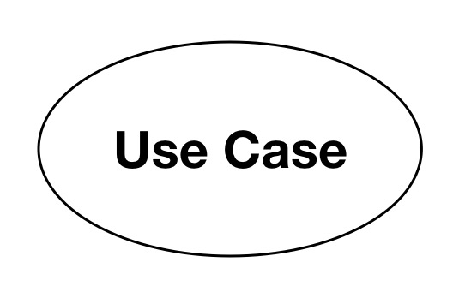
Key Components of Use Case Diagrams
Key Components of Use Case Diagrams
Actors
Use Cases
System
External entities that interact with the system, such as users, devices, or other systems.
Represent specific functionalities or tasks that the system performs.
System is used to define the scope of the use case and drawn as a rectangle
System

Slide 6
Key Components of Use Case Diagrams
Include
Exclude
The include relationship in a use case means one use case always uses the functionality of another use case as part of its process. It represents mandatory and reusable behavior shared by multiple use cases.
The extend relationship in a use case represents optional or conditional behavior that adds extra functionality to another use case. The extended use case only occurs under specific conditions.

Slide 7
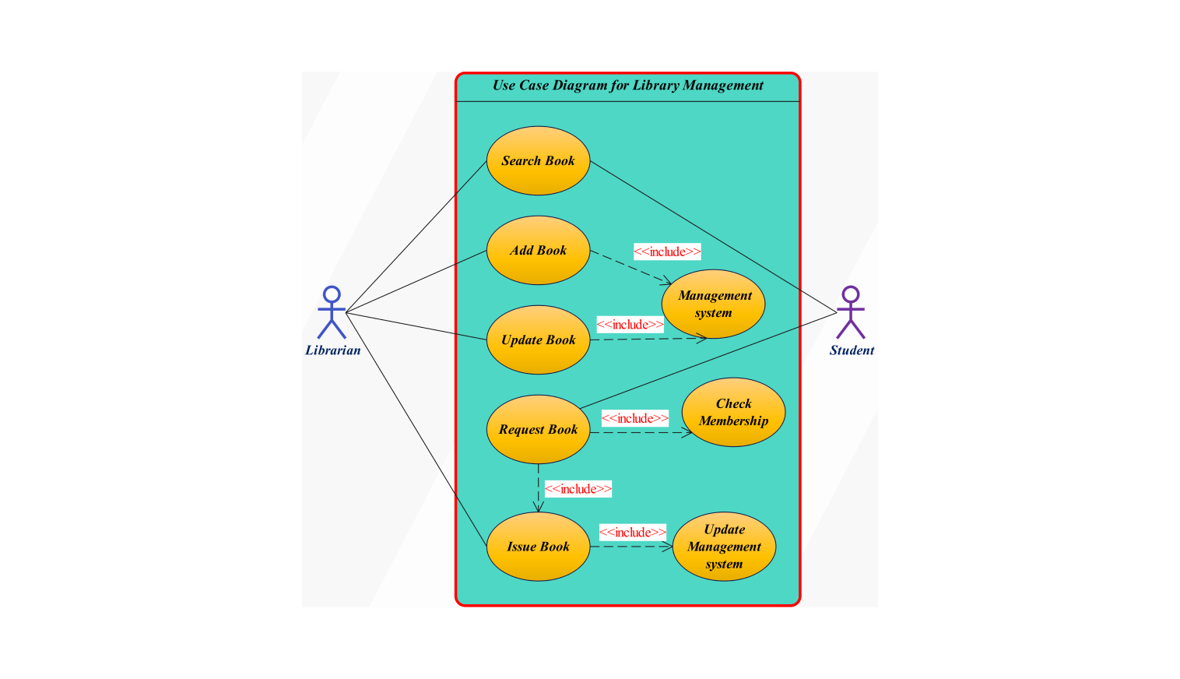

Slide 8

Purpose and Structure of Sequence Diagrams
1
2
3
Visualize interactions and message flow between objects in a system over time.
Represent the sequence of events that occur during a specific scenario.
Include lifelines for objects, messages exchanged between them, and activations representing object execution.

Slide 9
Understanding Sequence Diagrams
Definition
Importance
Sequence diagrams are a type of UML diagram that visually illustrate the sequence of interactions between objects or participants in a system.
They are particularly valuable in software engineering for understanding the flow of messages and events within a system.

Slide 10
Essential Elements of a Sequence Diagram
Actors
Lifelines
Messages
Actors represent external entities that interact with the system, such as users, other systems, or databases. They are typically depicted as stick figures.
Lifelines are vertical lines representing individual objects or participants within the system. They indicate the duration of the object's existence throughout the sequence of interactions.
Messages are arrows that show communication between different lifelines. They represent the interactions between objects, such as function calls or data exchanges.
Activation Bars
Objects
Activation bars are rectangles that represent the period during which an object is actively processing a message. They indicate the object's state of activity.
Objects are entities within the system that perform specific roles or hold data. They are instances of classes in object-oriented design.

Slide 11

Actor
Lifeline
Activation bar

Slide 12
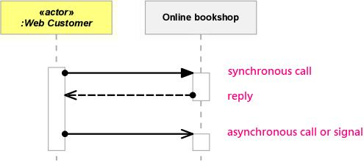
Understanding the Flow of Messages
Synchronous Messages
Asynchronous Messages
Return Messages
Synchronous messages require a response before the sender can continue. They are represented by a solid arrow with a full arrowhead.
Asynchronous messages do not require a response and allow the sender to continue processing. They are represented by a dashed arrow with a half arrowhead.
Return messages indicate the response to a synchronous message. They are represented by a dotted arrow with a half arrowhead, and are typically drawn back to the sender.

Slide 13
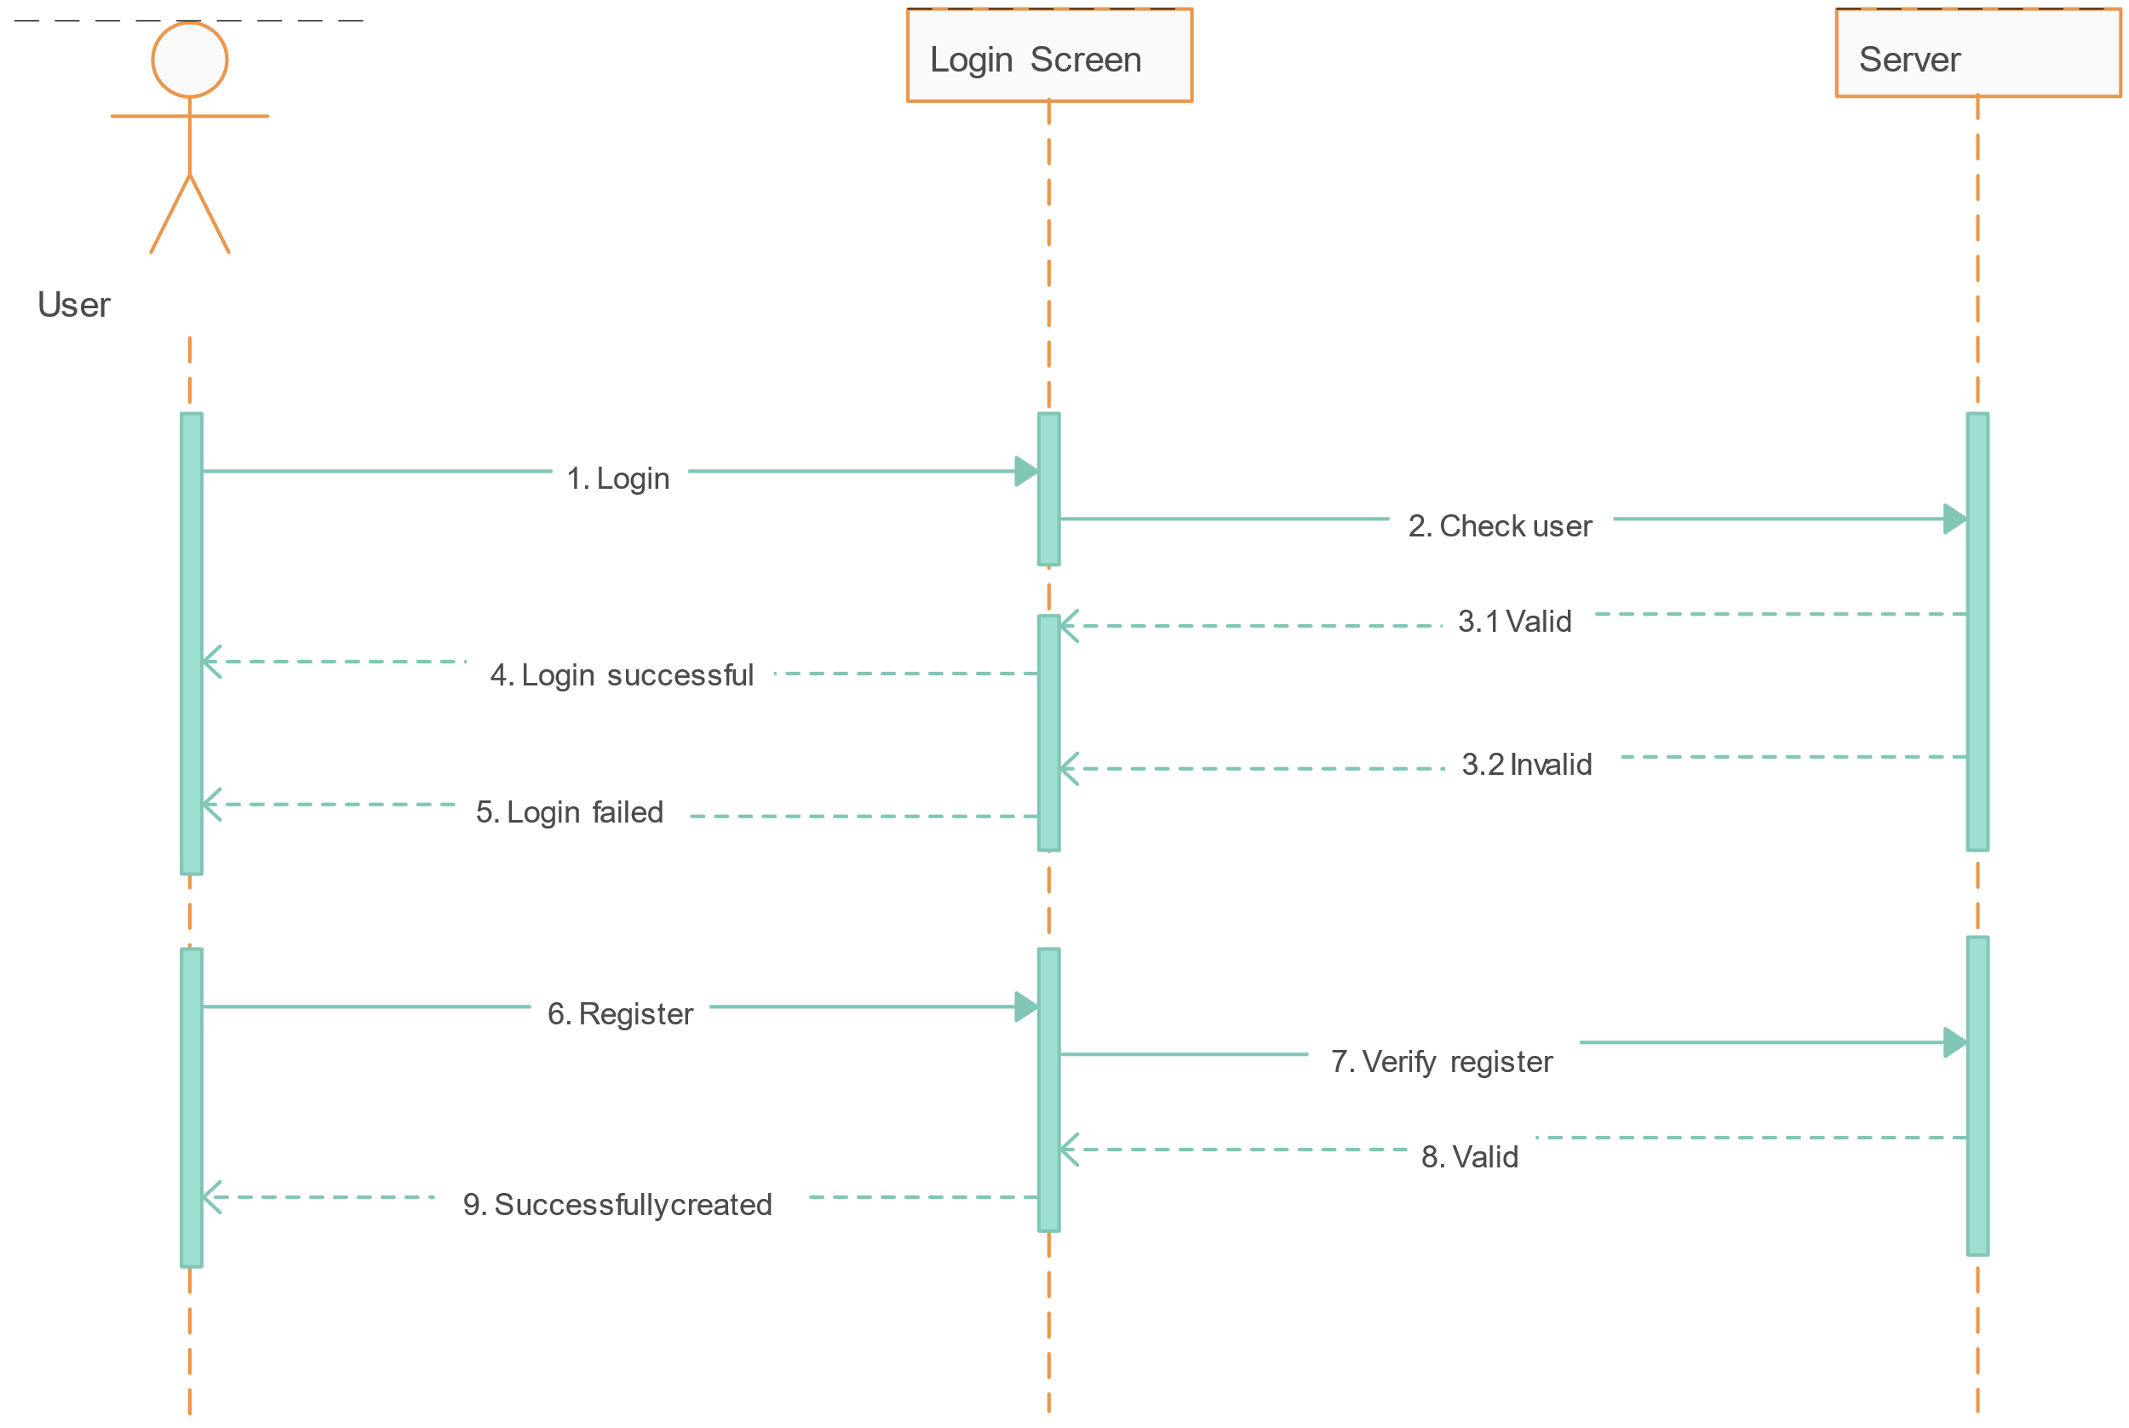

Slide 14
THANKS FOR YOUR CONCENTRATION
THE END…….

